Slide 1
Learn JIRA Basics
By Sam Lee Credit To Atlassian For Providing The Training

Slide 2
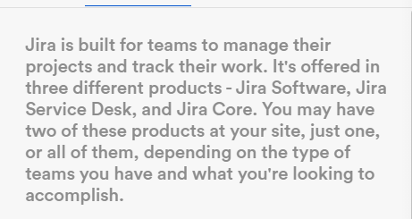
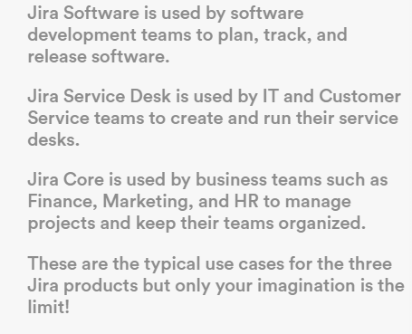
What is JIRA

Slide 3

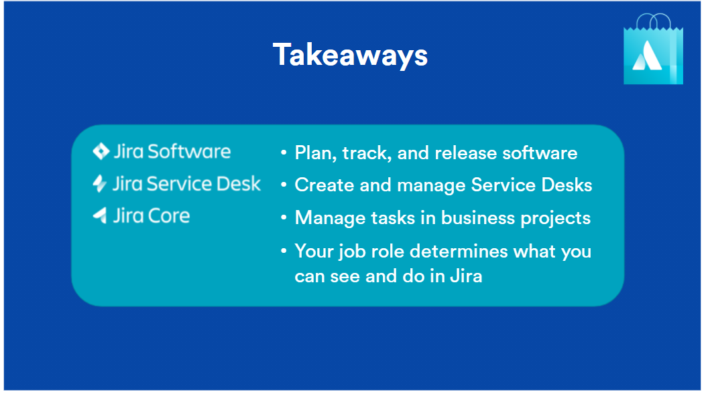
Three Ways JIRA Is Used
JIRA Software – Development
JIRA Service Desk – IT & Customer Service
JIRA Core – Business (mainly not applicable to engineers)

Slide 4
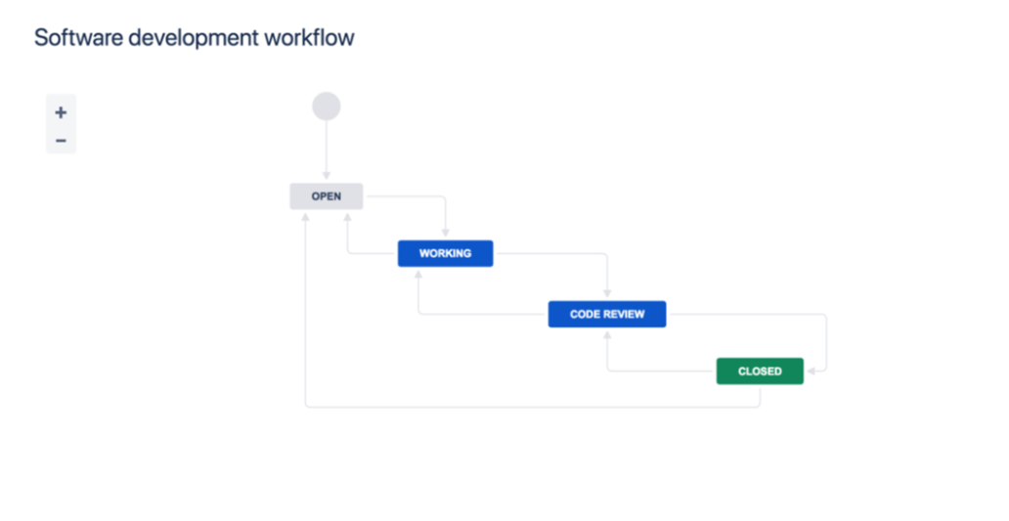
Project Workflow
Open -> In Progress -> Code Review -> Done

Slide 5
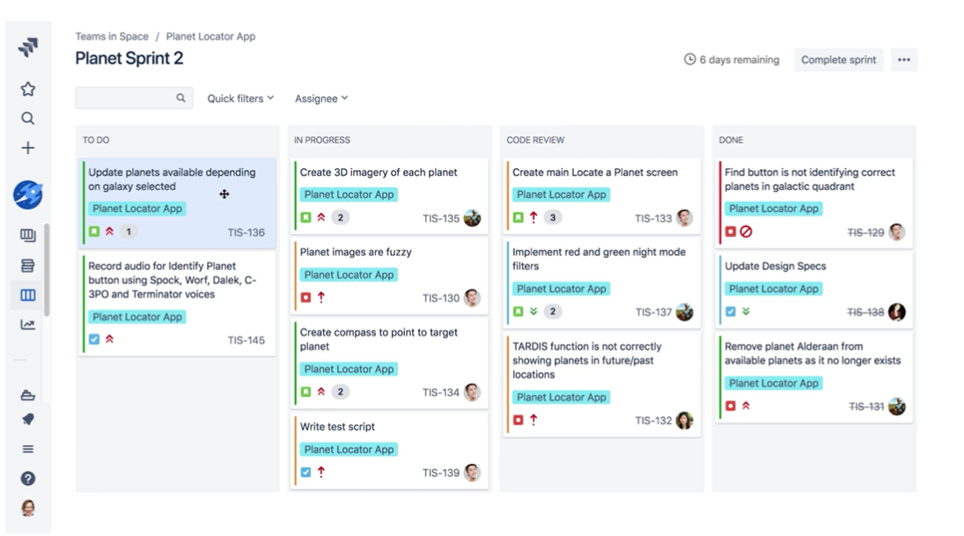
JIRA Software Example

Slide 6
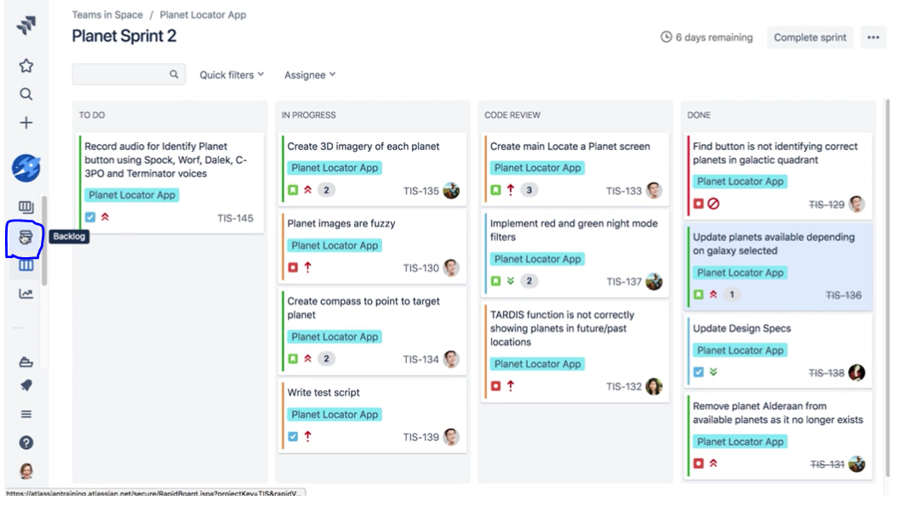
JIRA Software Example

Slide 7
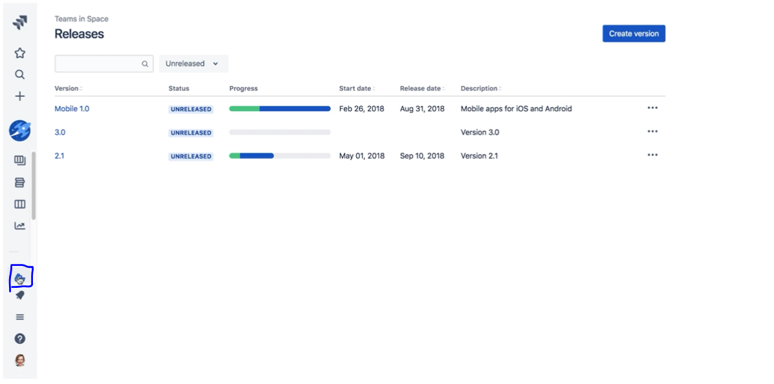
JIRA Software Example

Slide 8
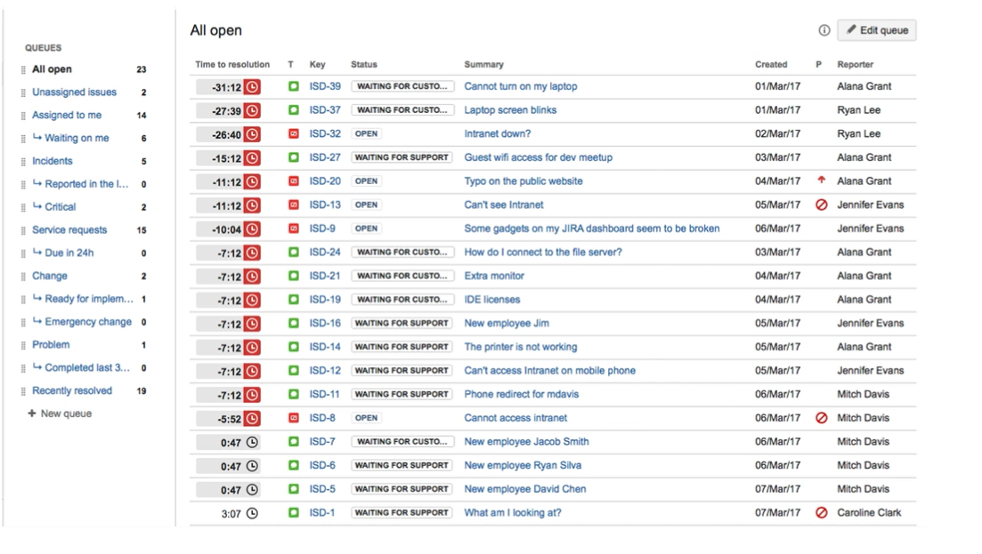
JIRA Service Desk Example

Slide 9
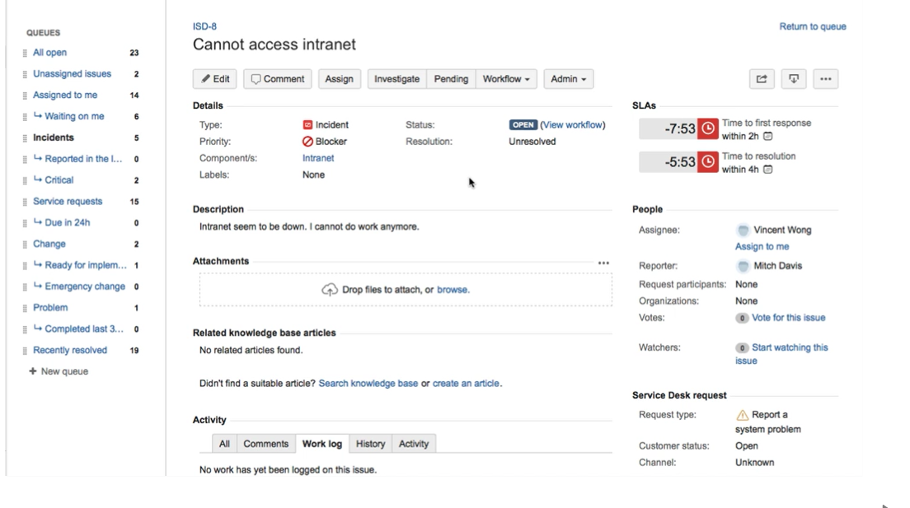
JIRA Service Desk Example

Slide 10
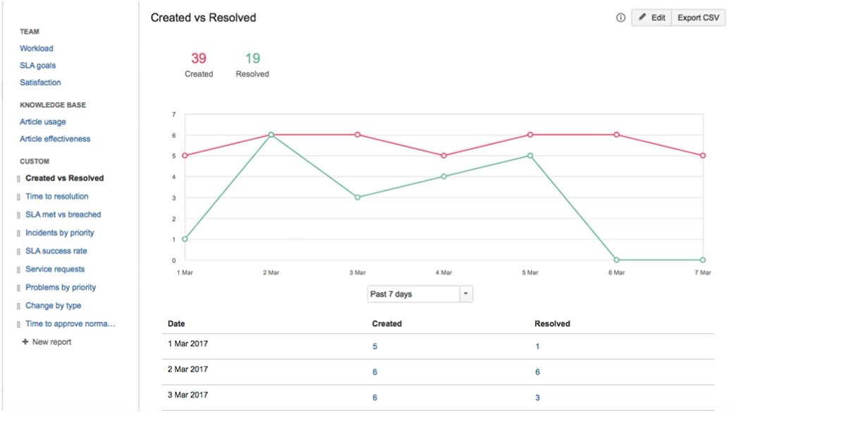
JIRA Service Desk Example

Slide 11
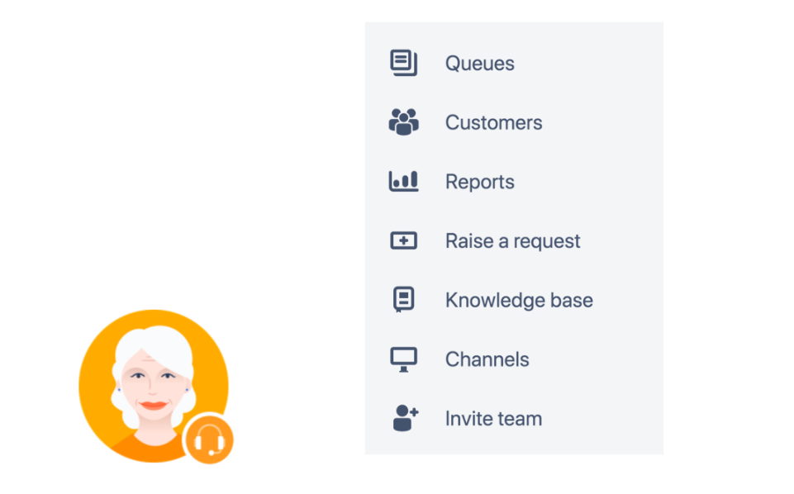
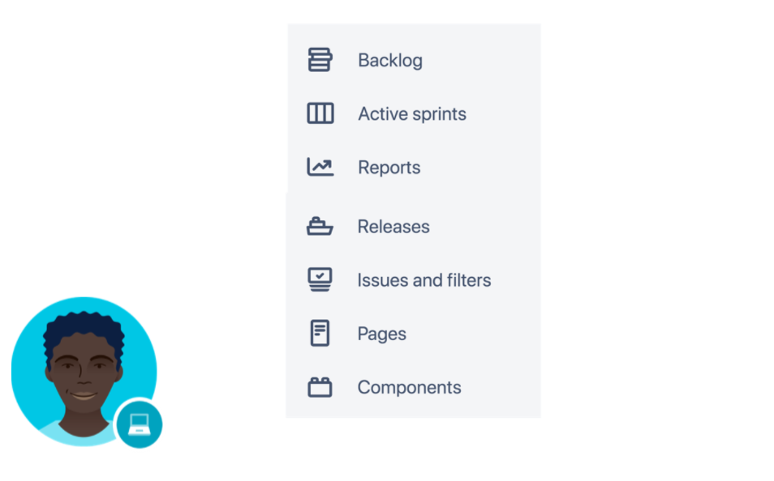
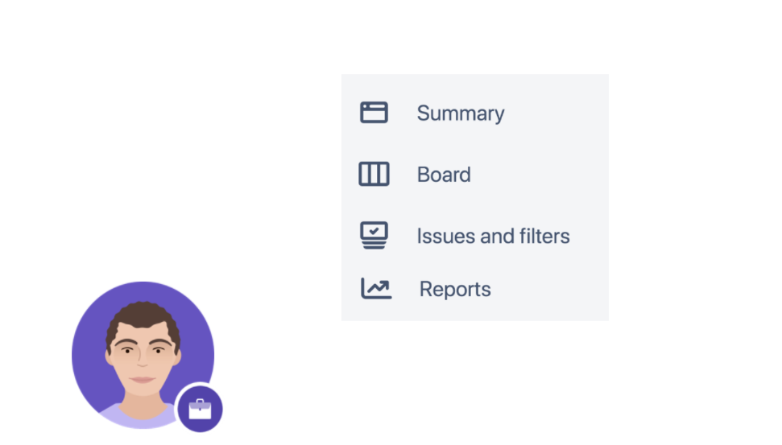
JIRA Menus For Each Type

Slide 12
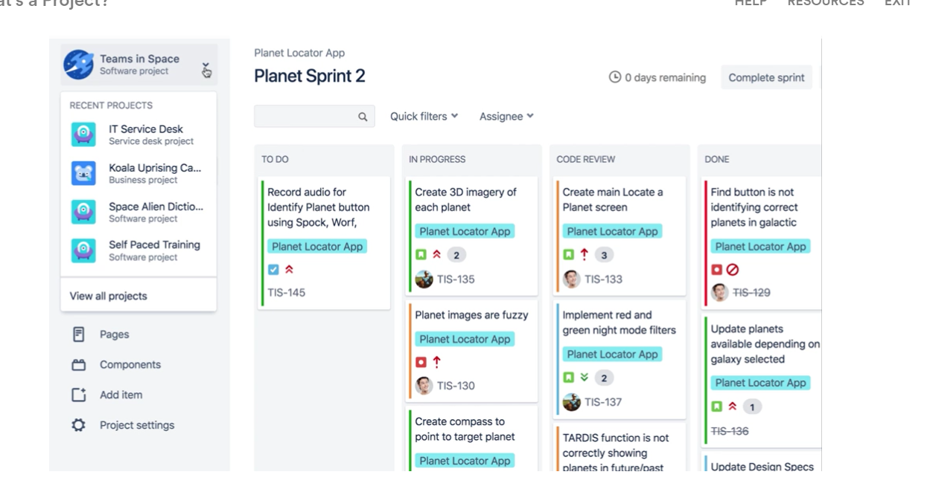
Navigating Through Projects

Slide 13
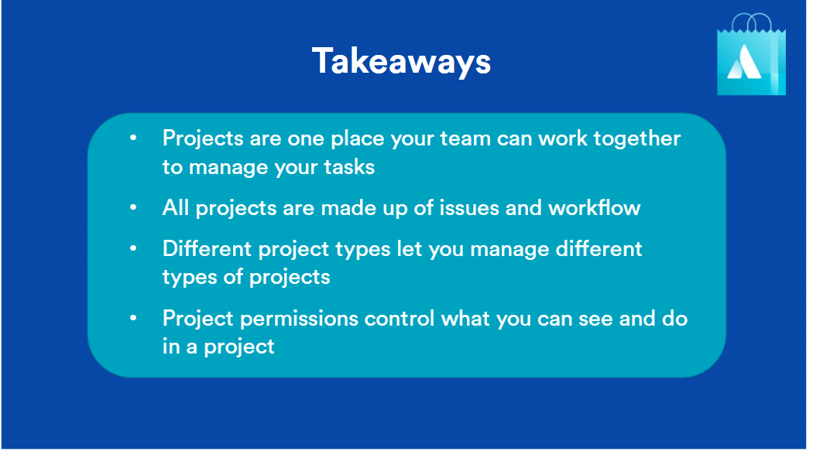
Some Key Takeaways

Slide 14
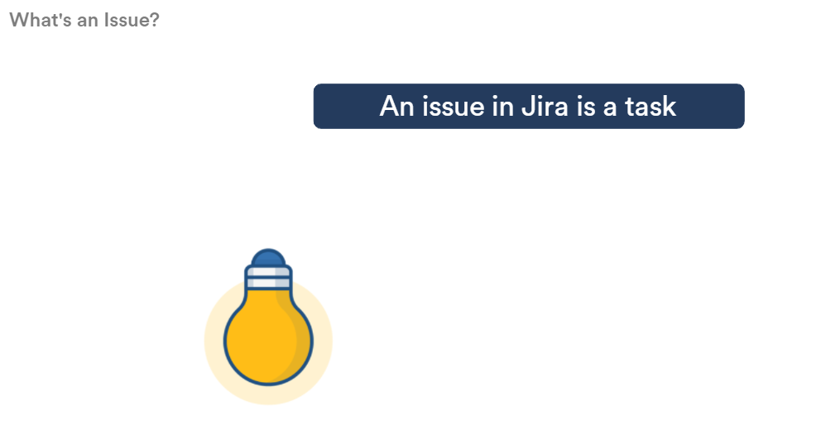
What Is An JIRA Issue?

Slide 15
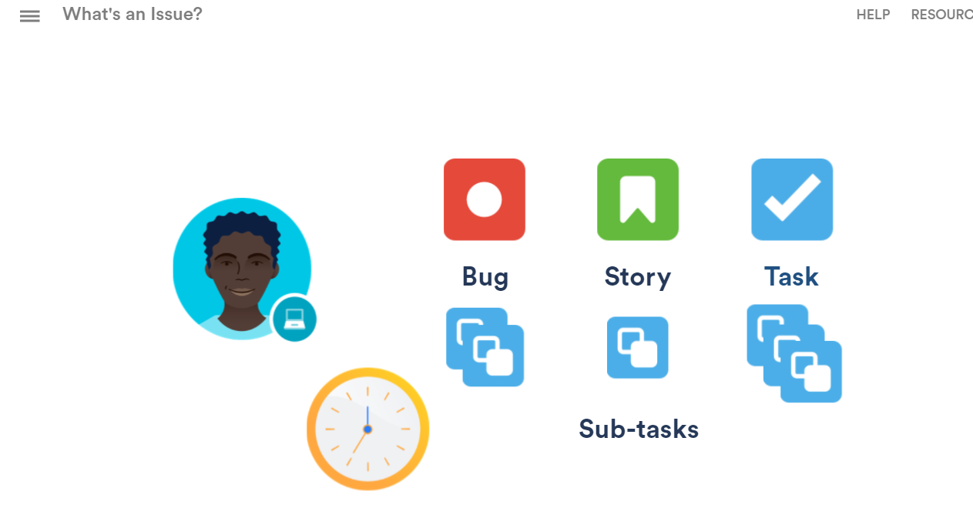
Software Project Issues

Slide 16
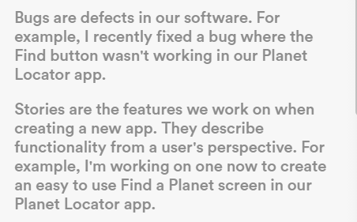
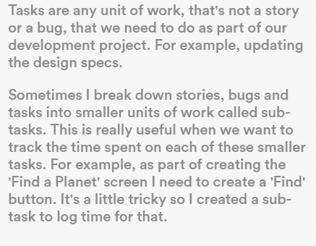
Software Project Issues

Slide 17
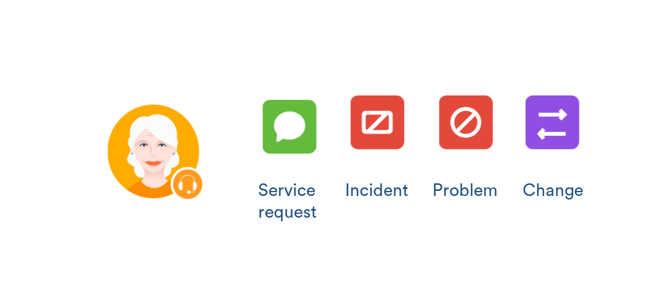
Service Desk Issues

Slide 18
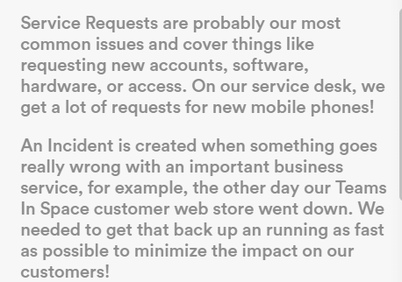
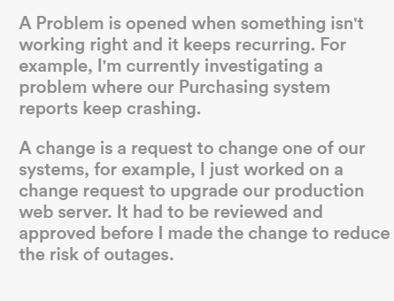
Service Desk Issues

Slide 19
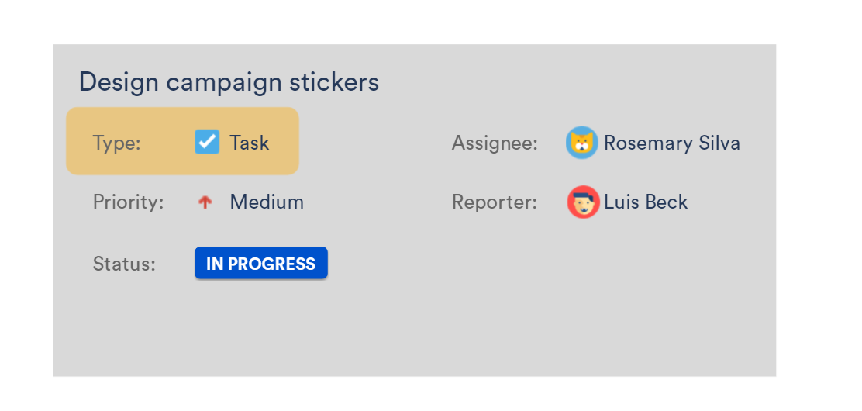
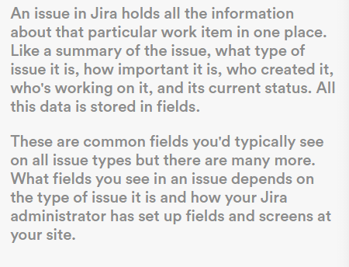
Aspects Of An Issue Example

Slide 20
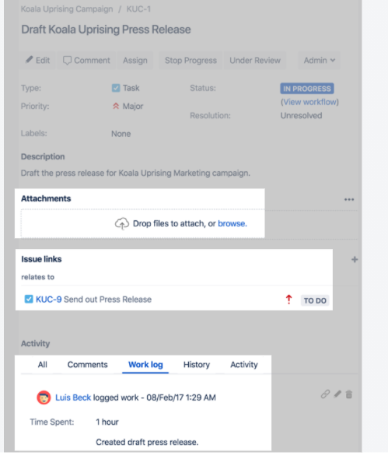
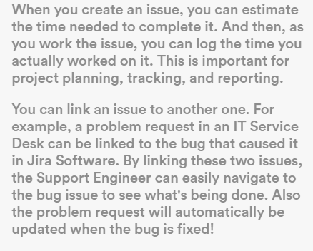
Aspects Of An Issue Example

Slide 21
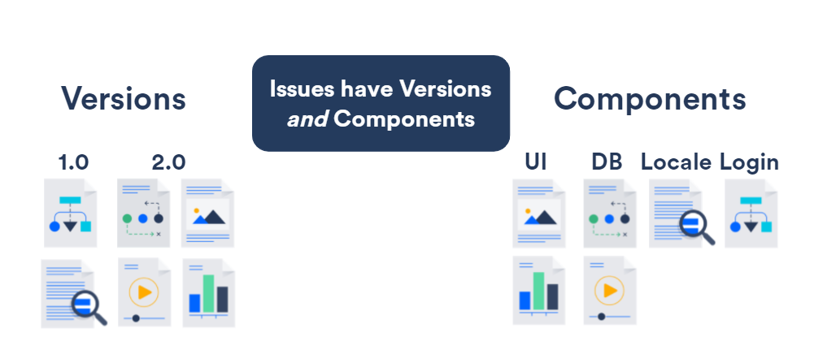
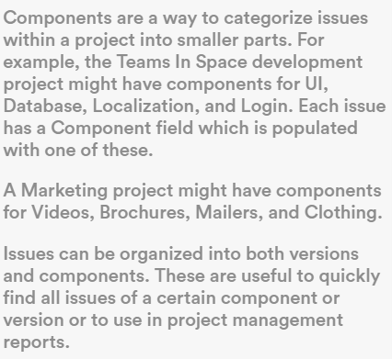
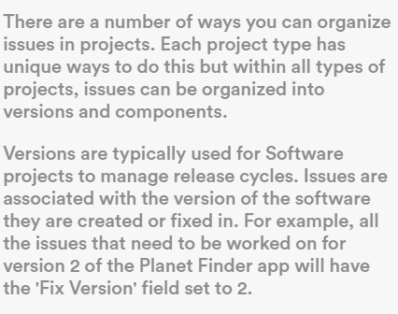
Aspects Of An Issue Example

Slide 22
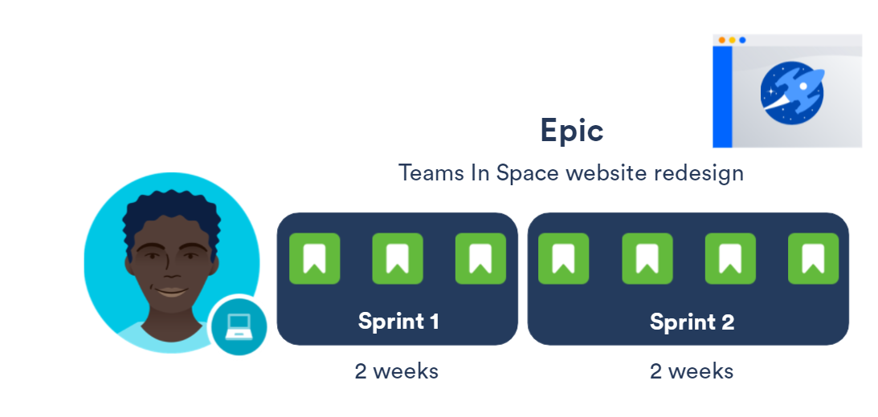
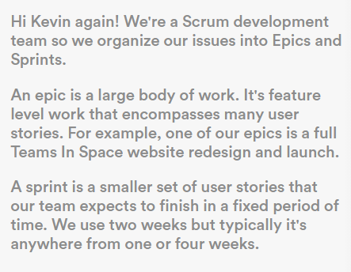
JIRA Software Epics And Sprints

Slide 23
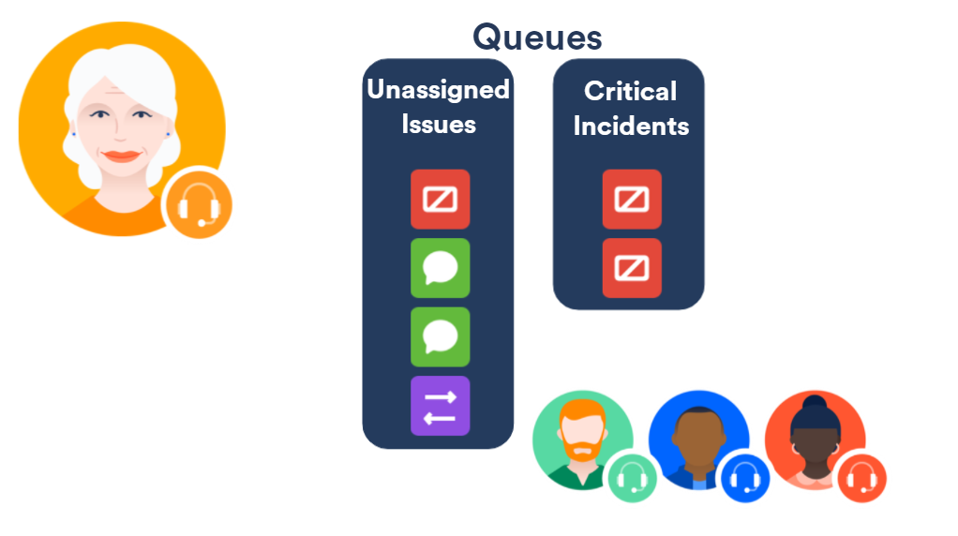
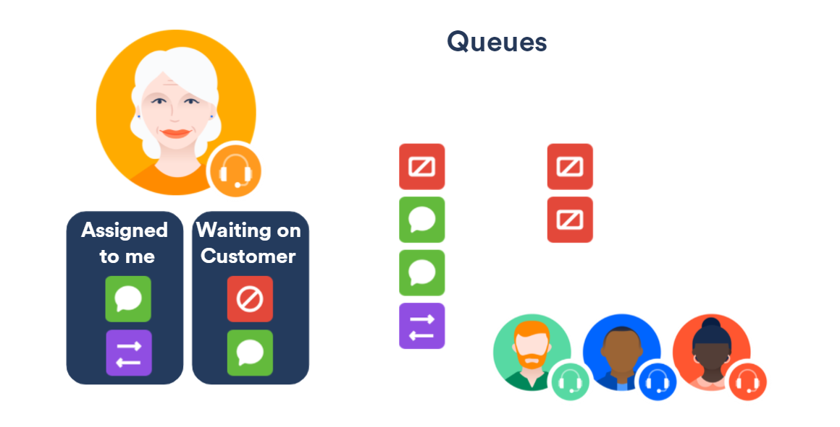
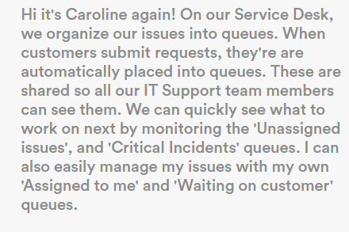
JIRA Service Desk Queues

Slide 24
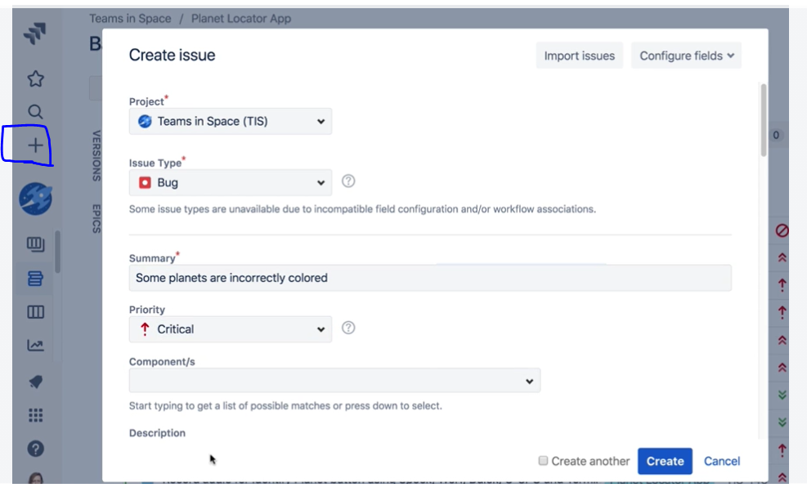
Creating An Issue Example

Slide 25
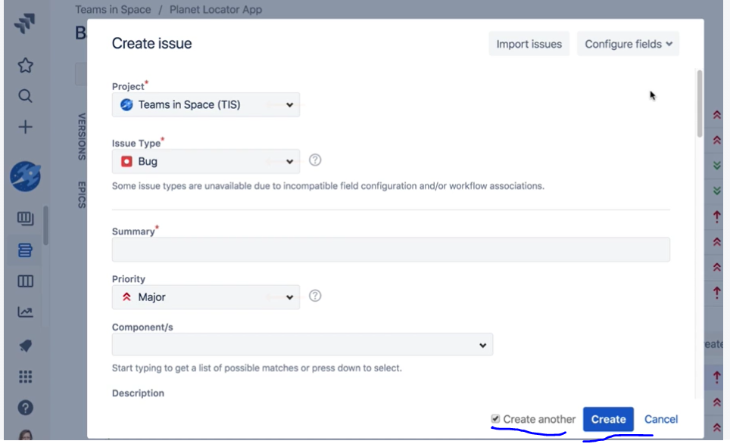
Creating Multiple Issues Example

Slide 26
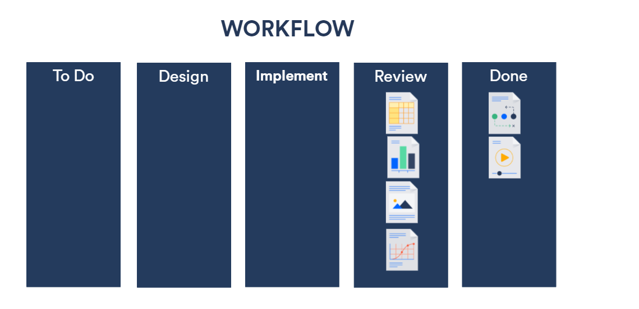
How Issues Get Done

Slide 27
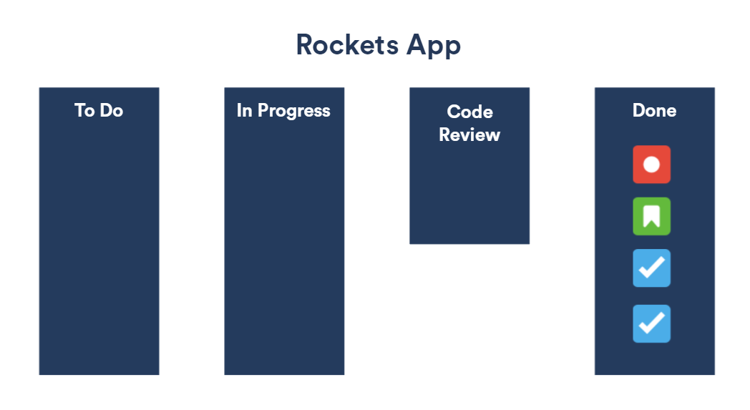
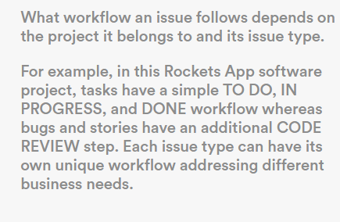
Issue Types And Workflow
Tasks - To Do -> In Progress -> Done
Bugs/Stories - To Do -> In Progress -> Code Review -> Done

Slide 28
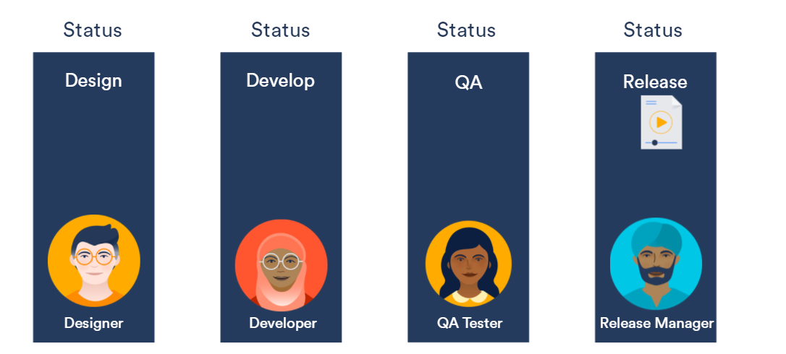
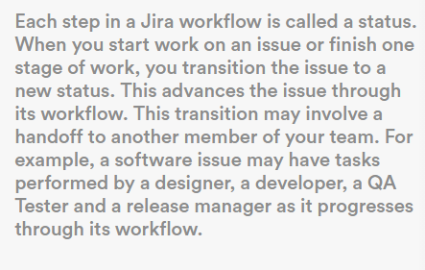
Statuses And Transitions

Slide 29
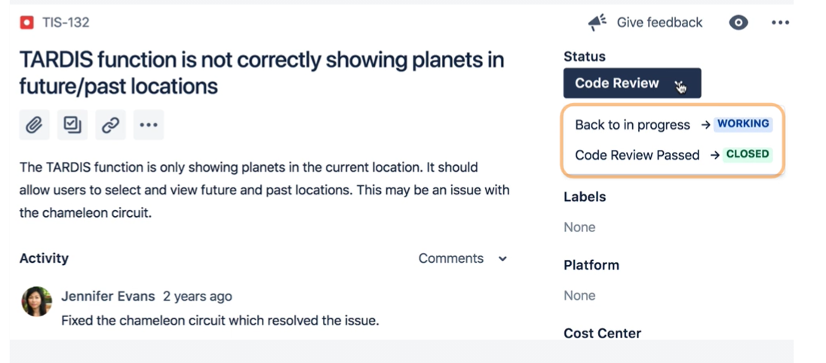
Advancing The JIRA Workflow

Slide 30
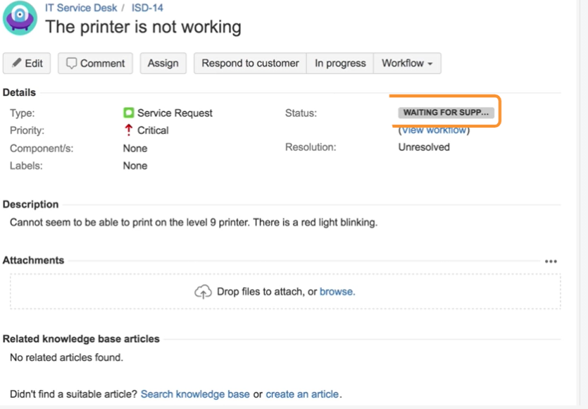
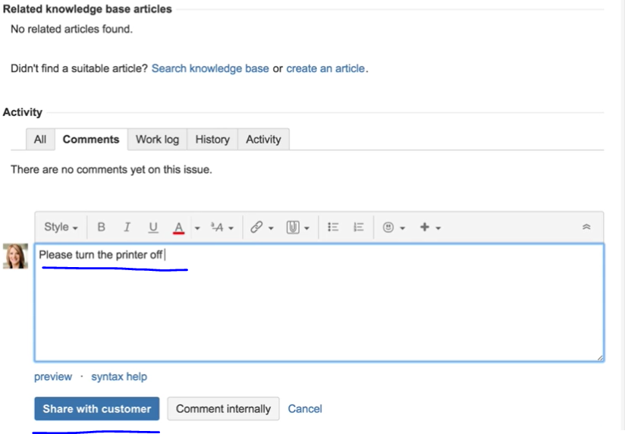
Workflow For JIRA Support Ticket

Slide 31
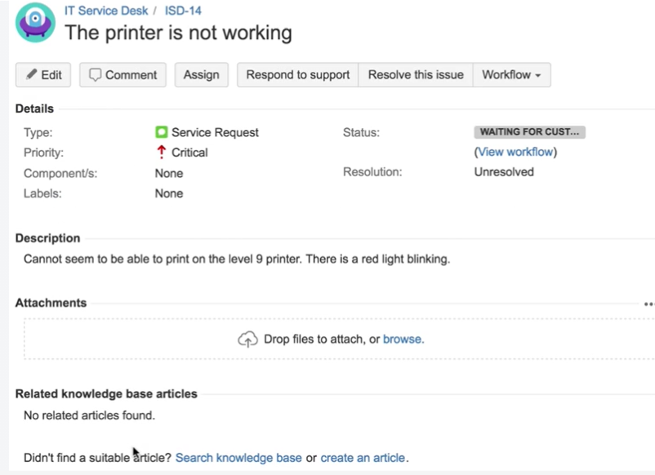
Workflow For JIRA Support Ticket

Slide 32
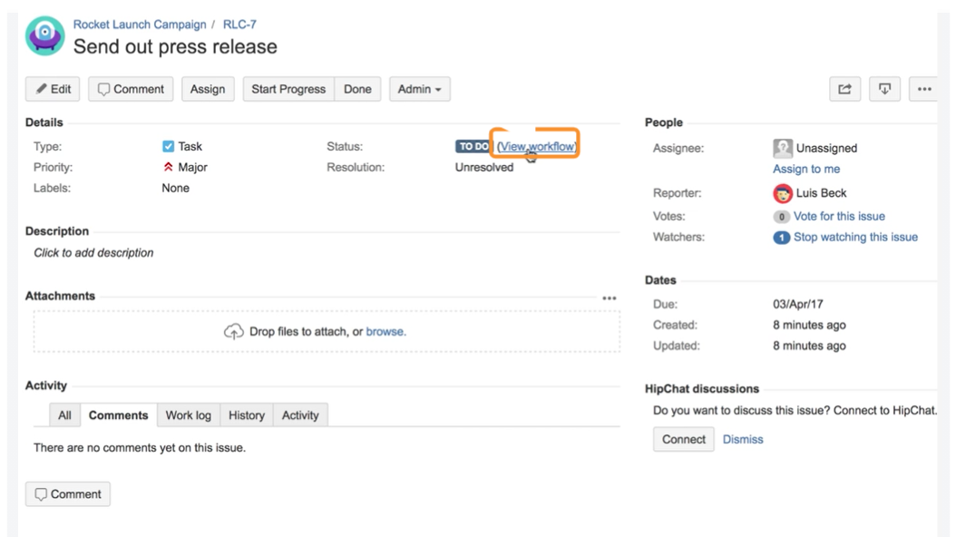
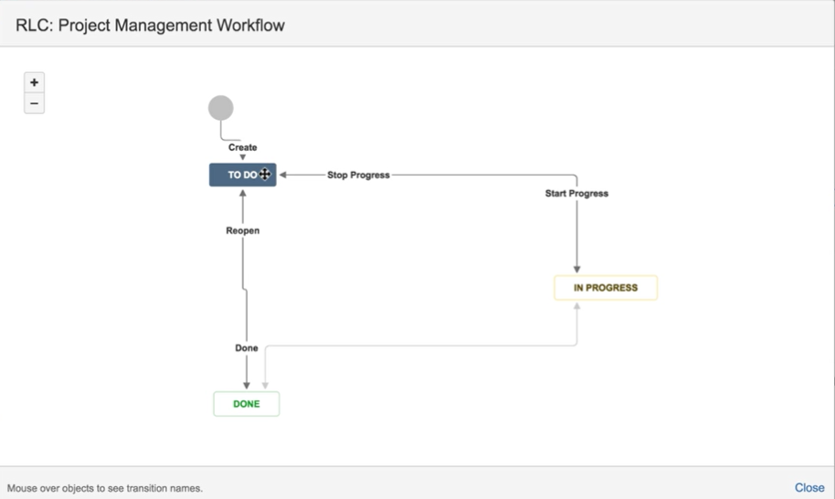
Viewing An Issue’s Workflow

Slide 33
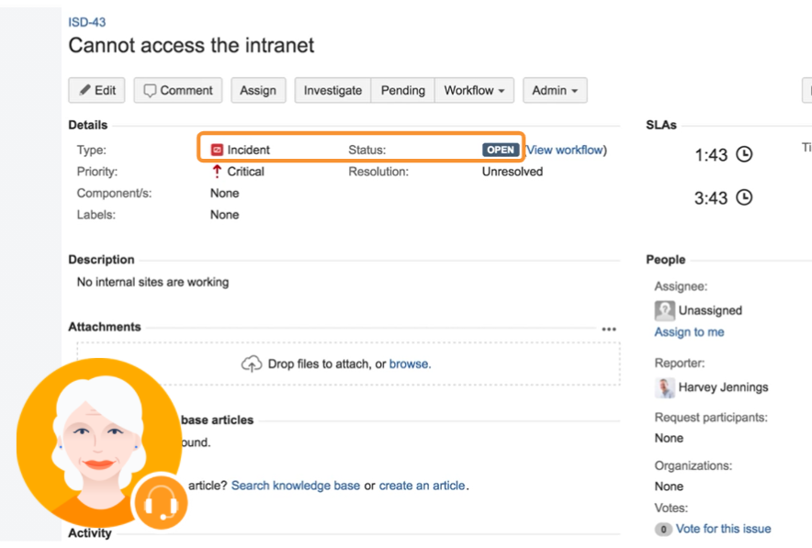
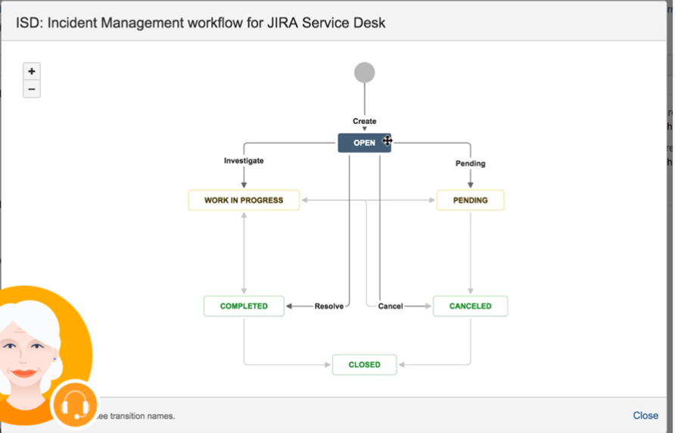
Service Desk Workflow Example

Slide 34
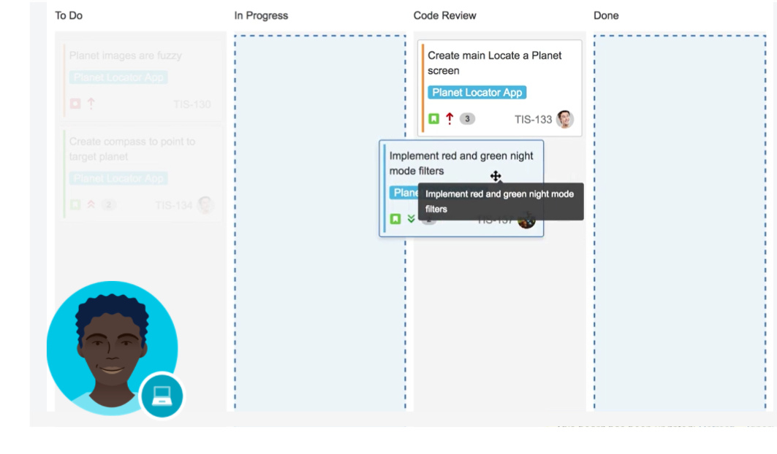
Software Workflow Example

Slide 35

Key Takeaways

Slide 36


Finding Issues Example

Slide 37

Searching Issues Example (Advanced)

Slide 38


Creating Filters

Slide 39

Key Takeaways

Slide 40

Built In Reports For JIRA Software

Slide 41

Built In Reports For JIRA Service Desk

Slide 42

Different Types Of Reports

Slide 43

Dashboard Creation Example

Slide 44

Dashboard Creation Example

Slide 45

Adding Gadgets Example

Slide 46

Adding Gadgets Example

Slide 47

Adding Gadgets Example

Slide 48

Adding Gadgets Example

Slide 49

Key Takeaways

